Slide 1
Fire size distributions and spread probability scaling
The following figures show how the simulated fire size distributions change depending on the values used to rescale spread values into probabilities (in FavierFireSense) – note that initial 0 values are kept at 0 (not the minimum value of the rescaling vector)
The observed distribution comes from the full data set of currently available fire polygons from the NFDB
Date: June 21-22, 2022 Project commit sha: d810fc892d99ac547be929a93655d377f459cd29

Slide 2
No partial mortality

Slide 3
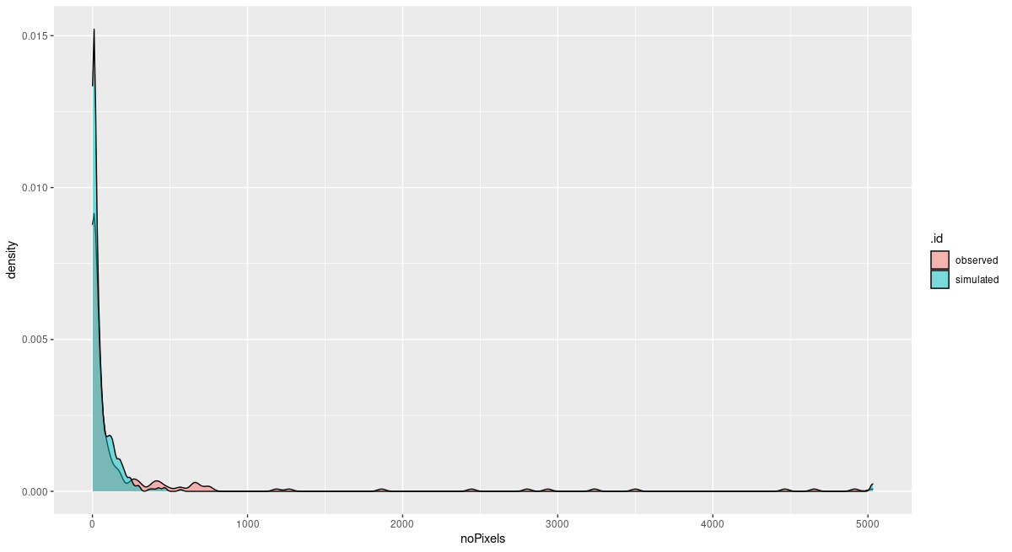
Spread probabilities rescaled to 0.2 – 0.25

Slide 4
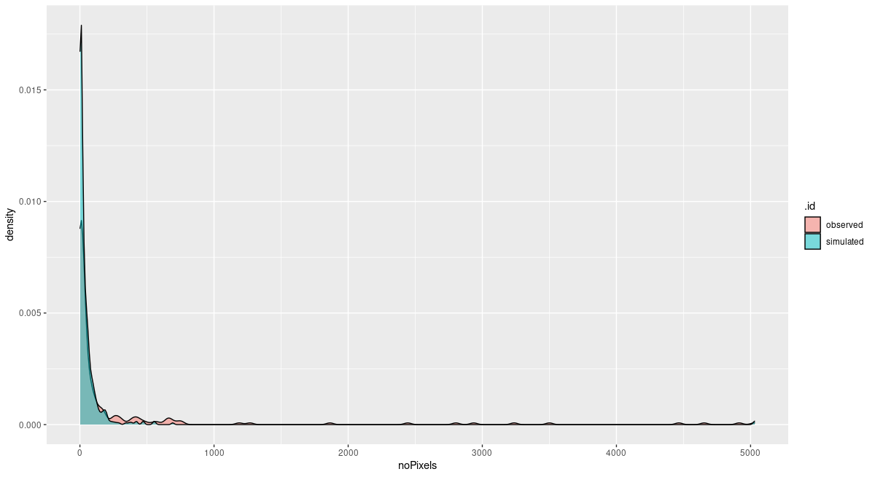
Spread probabilities rescaled to 0.2 – 0.26

Slide 5
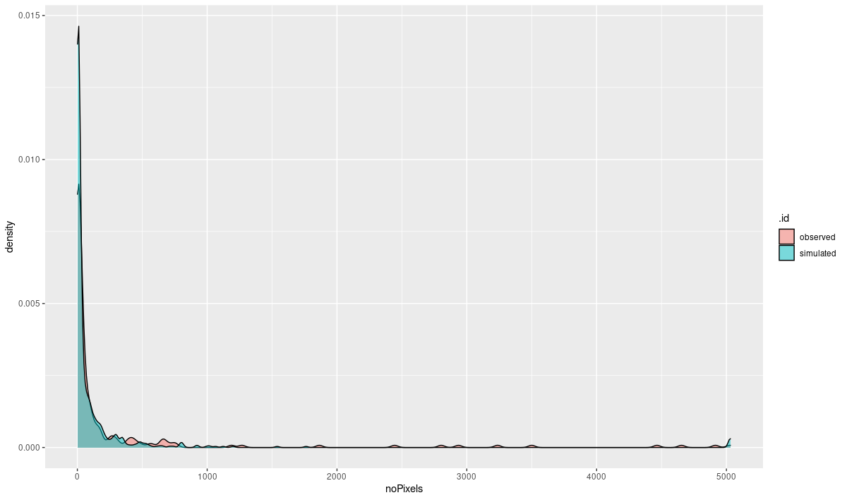
Spread probabilities rescaled to 0.22 – 0.25

Slide 6
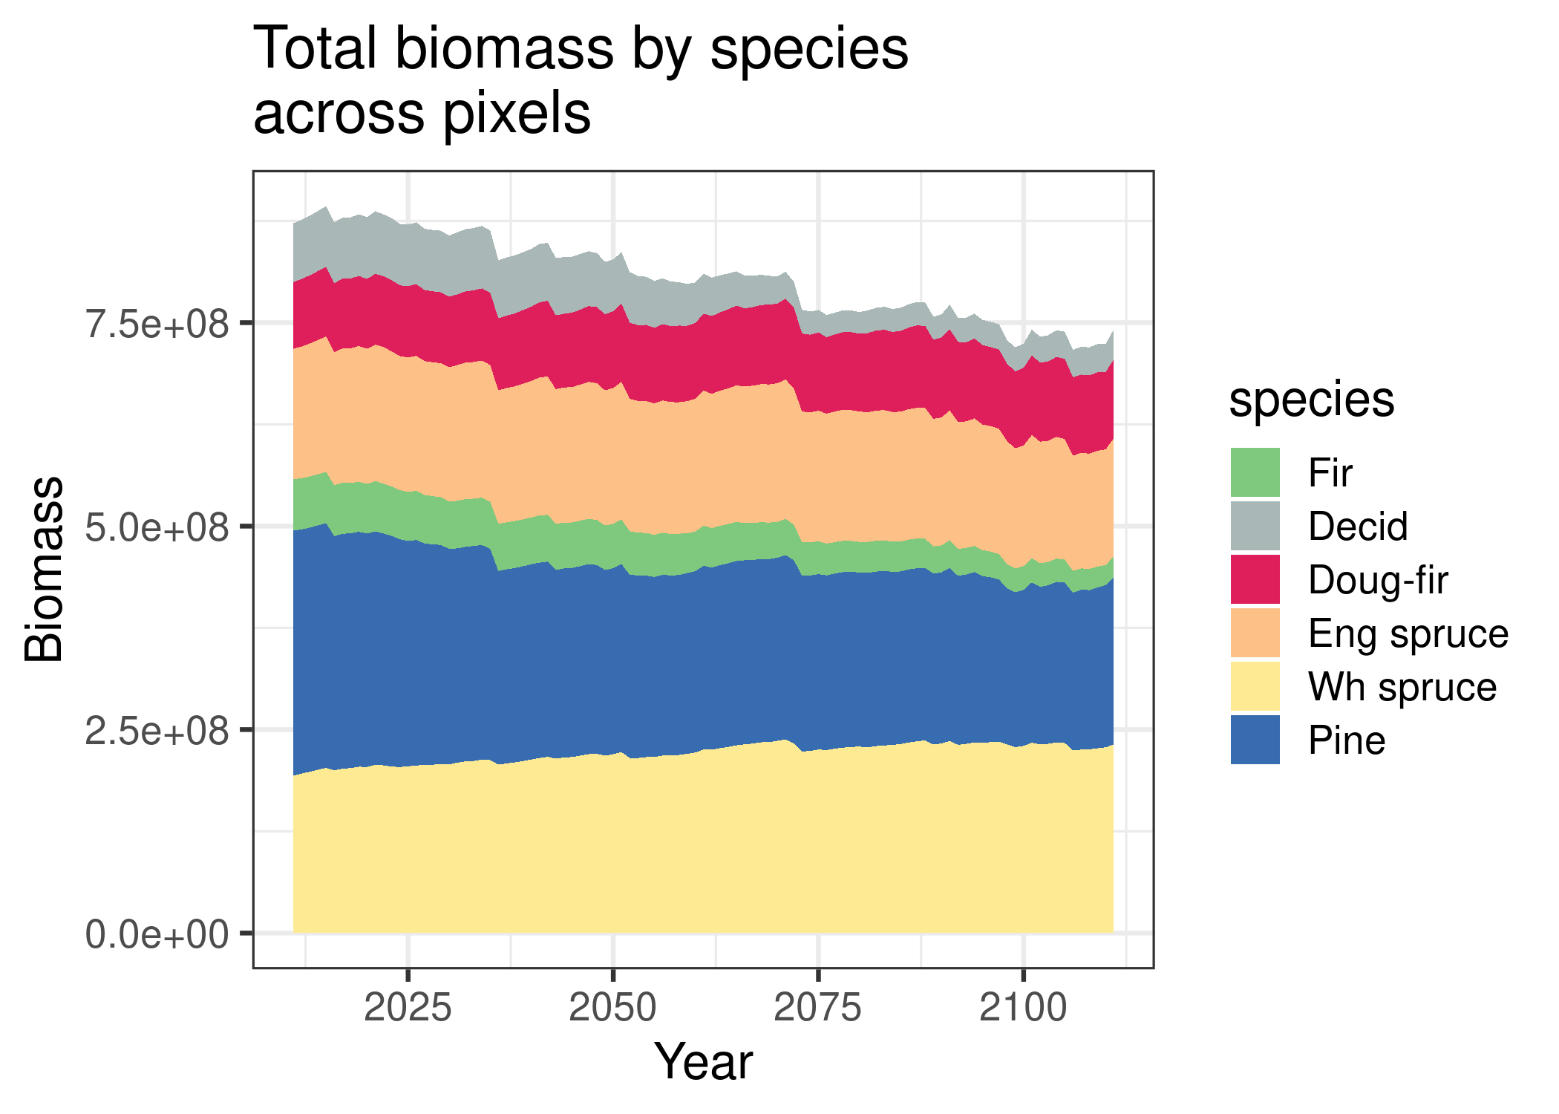
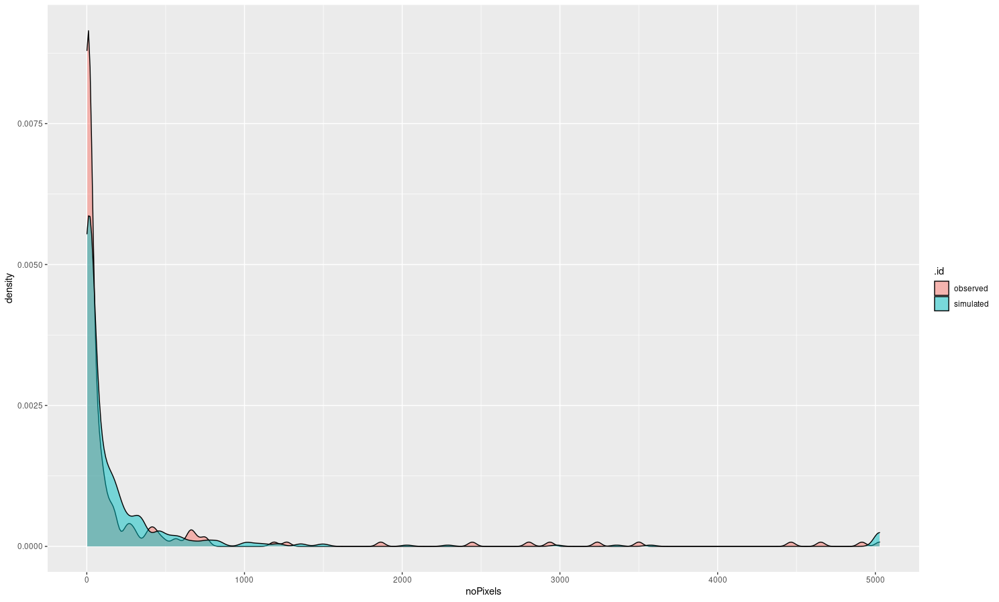
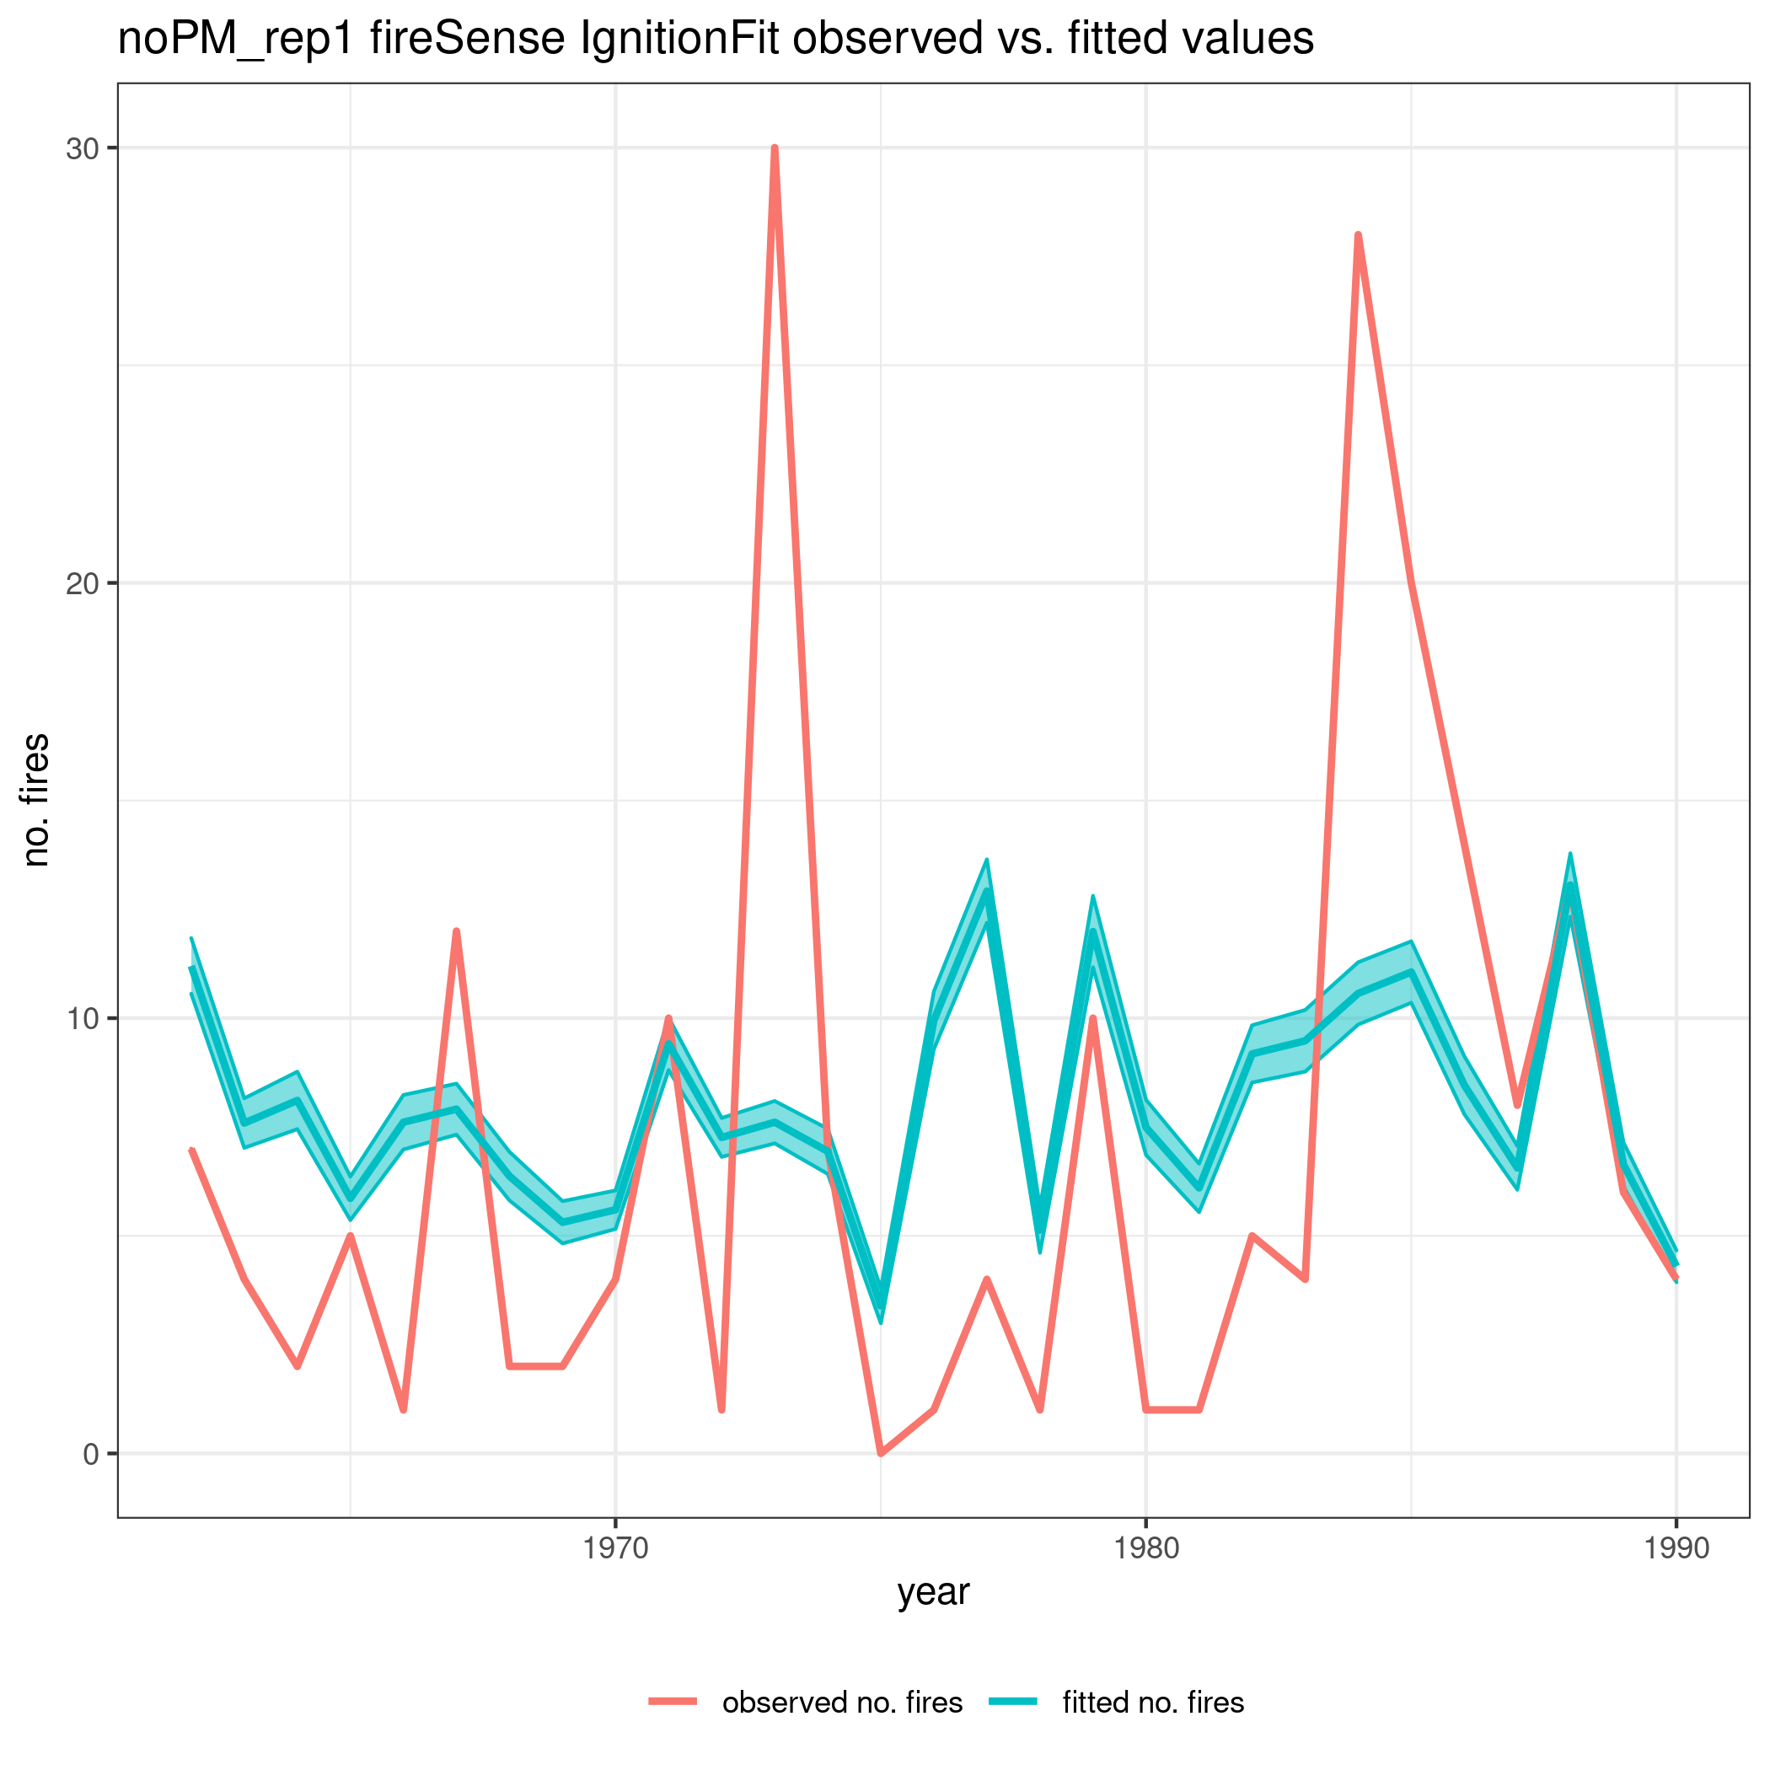
Spread probabilities rescaled to 0.23 – 0.25

Slide 7
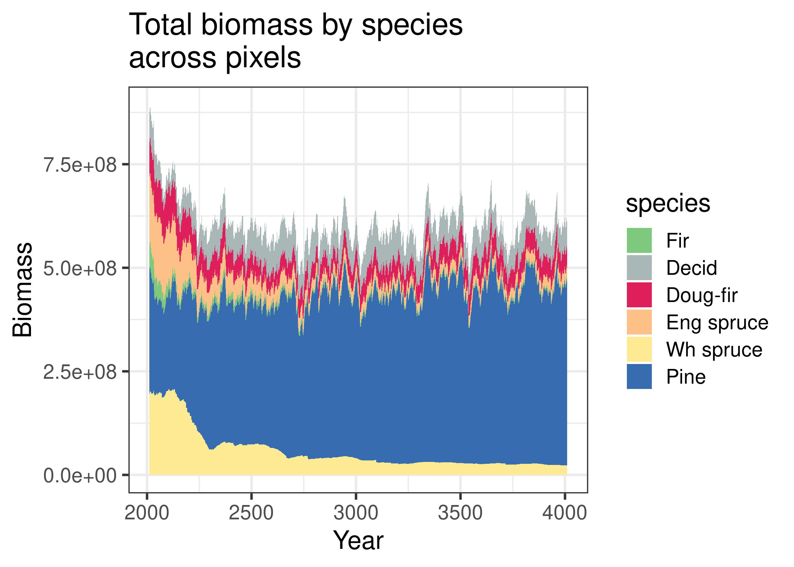
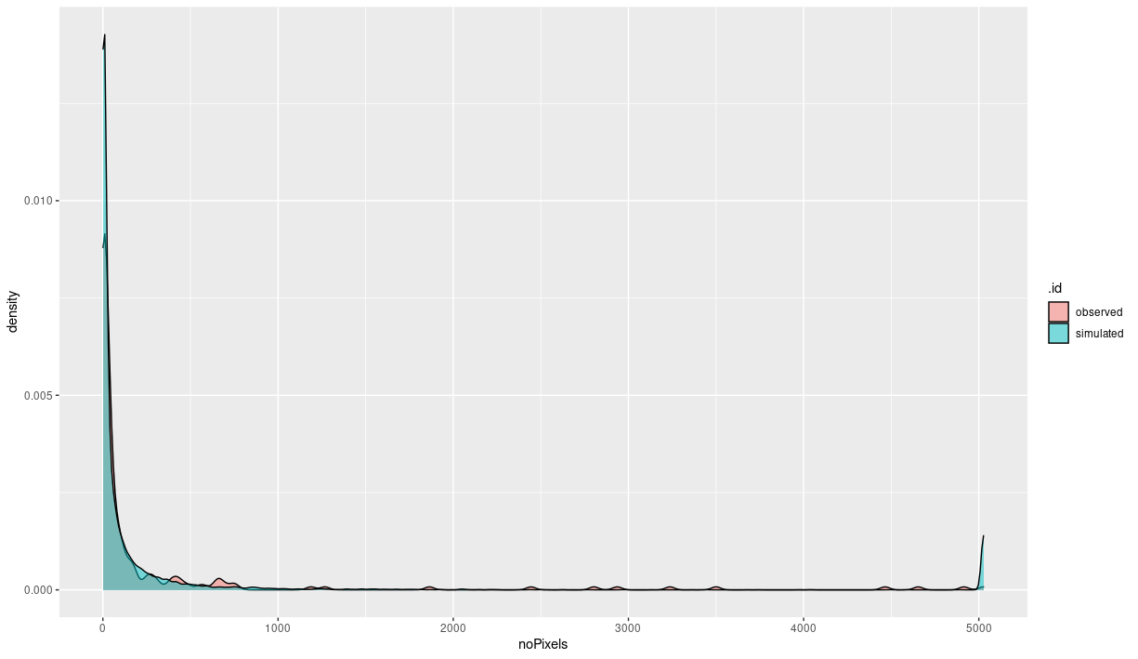
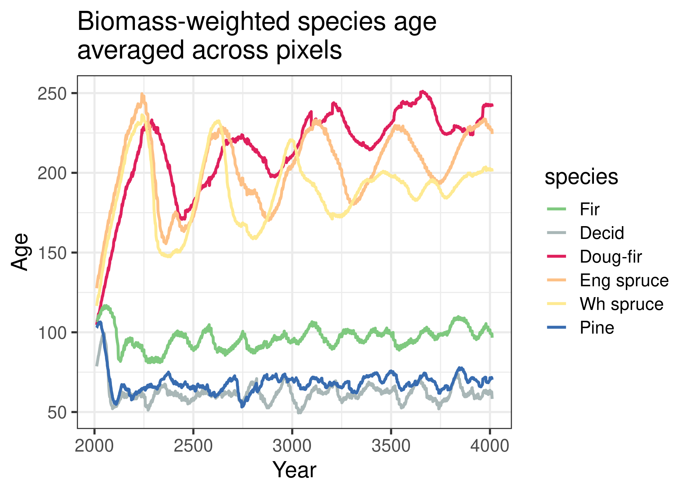
Spread probabilities rescaled to 0.23 – 0.25
2000yrs of sim

Slide 8
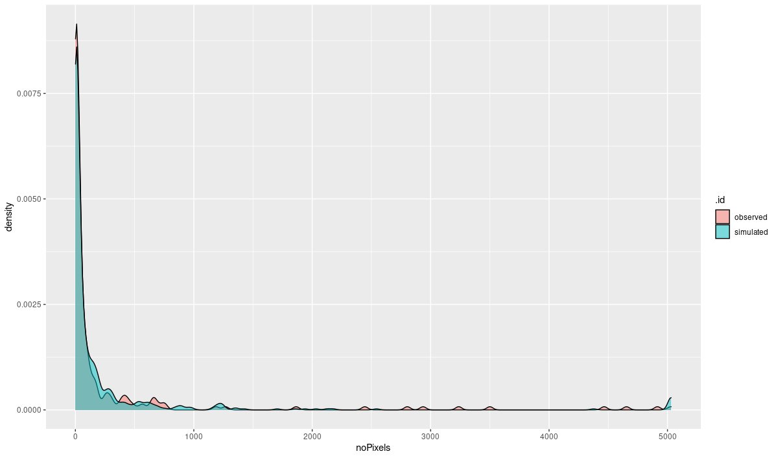
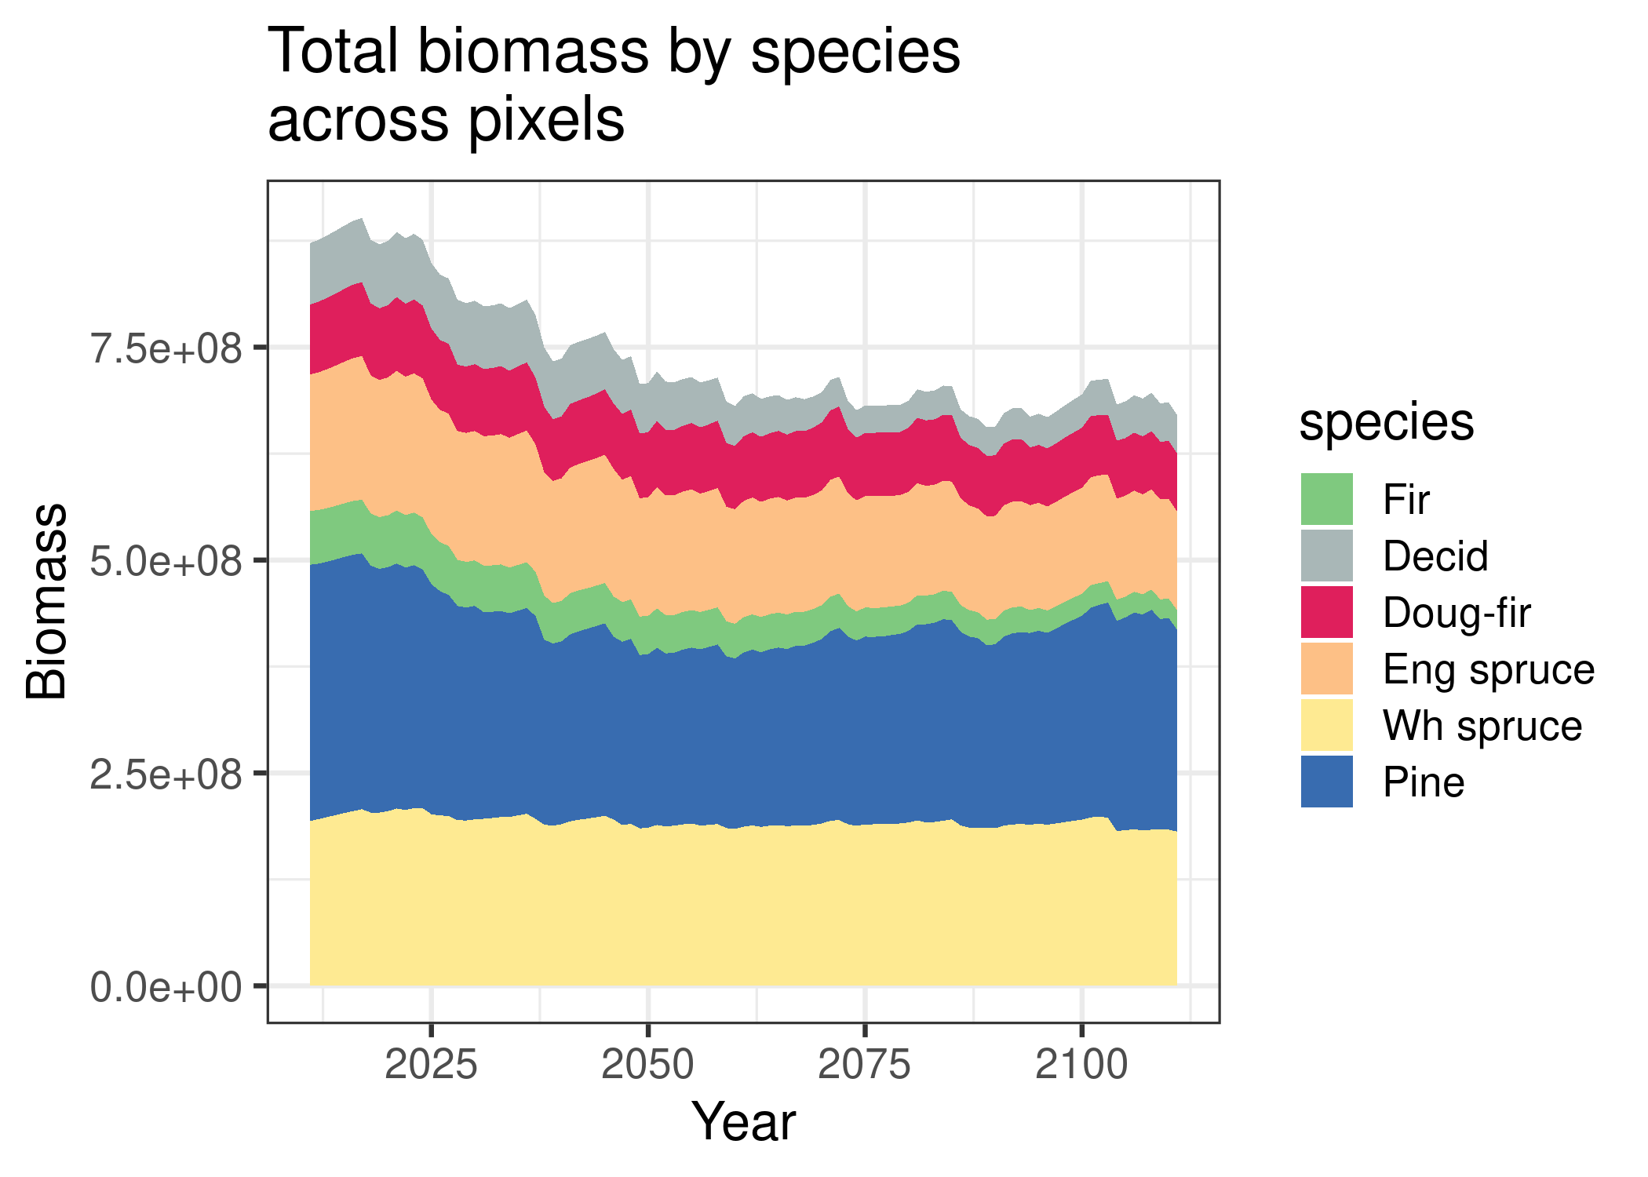
Spread probabilities rescaled to 0.23 – 0.26

Slide 9
with partial mortality

Slide 10
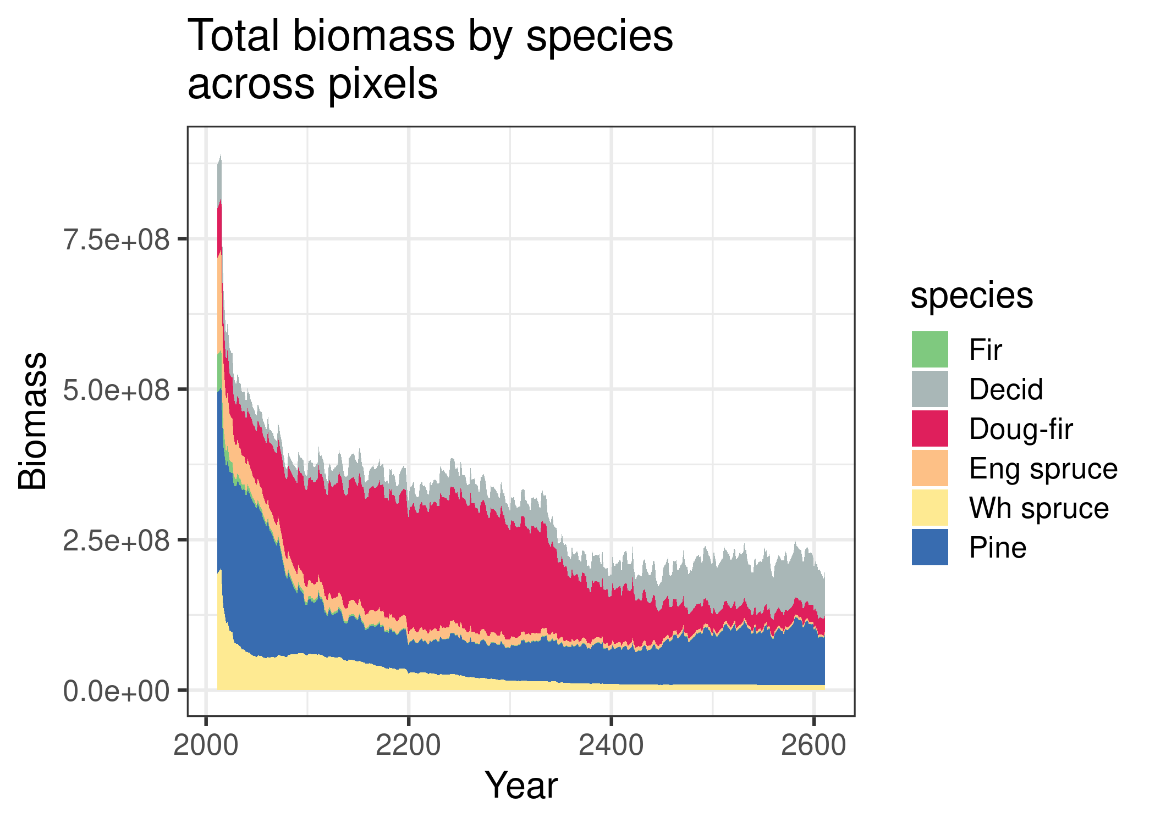
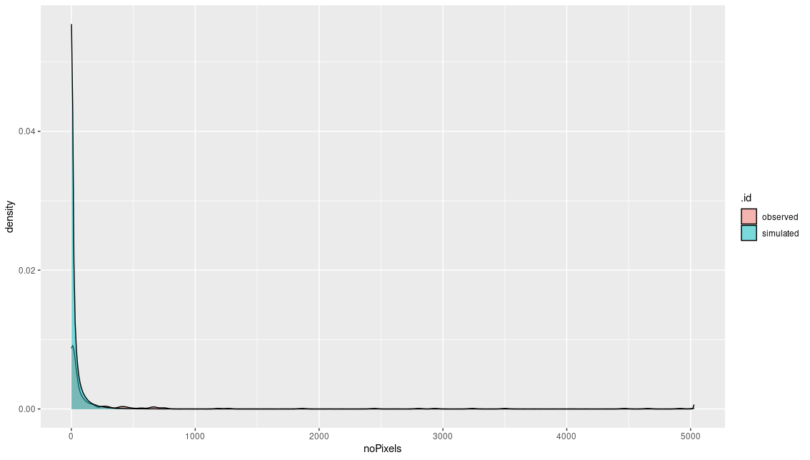
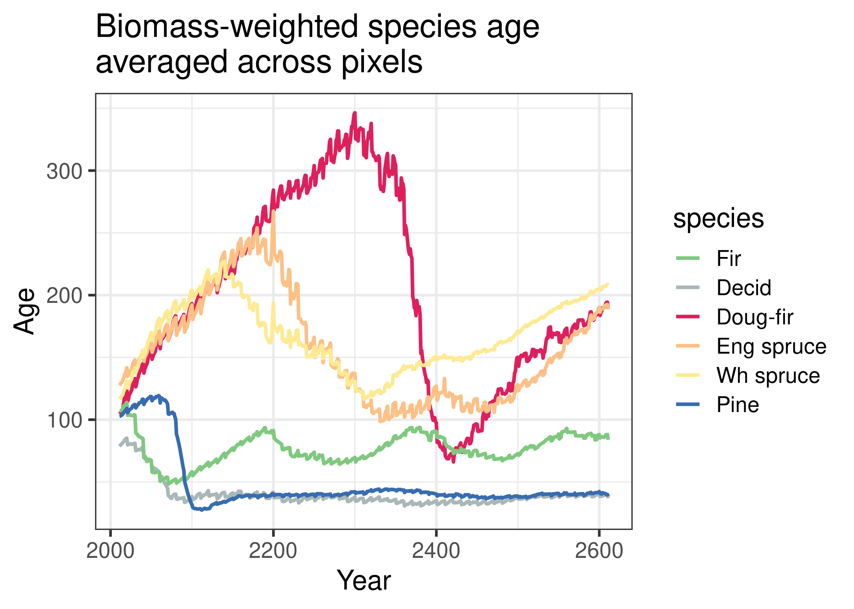
This drop comes from fireSense_Ignition fit not fitting the same model with `experiment2`
Spread probabilities rescaled to 0.23 – 0.25
600yrs of sim

Slide 11
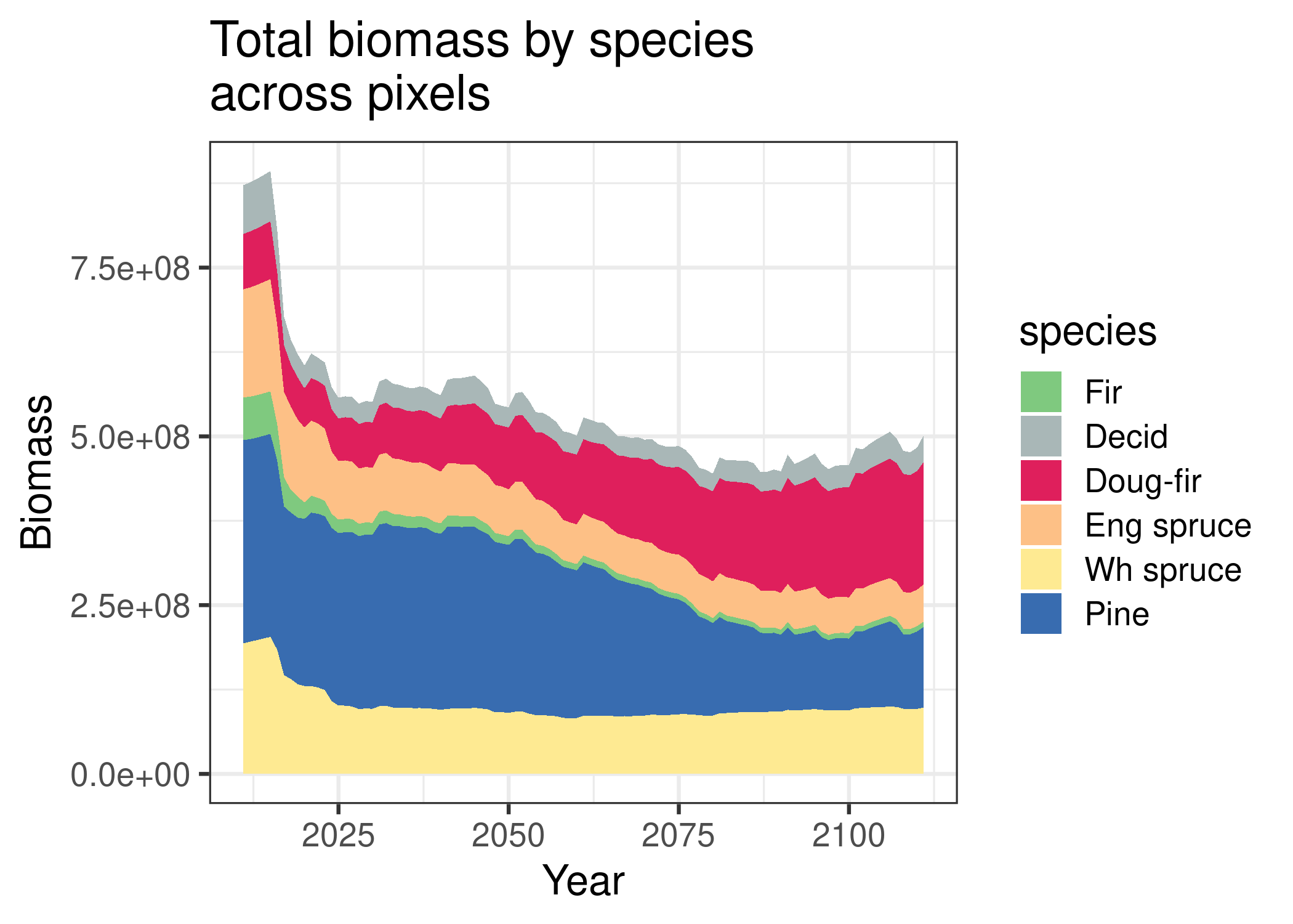
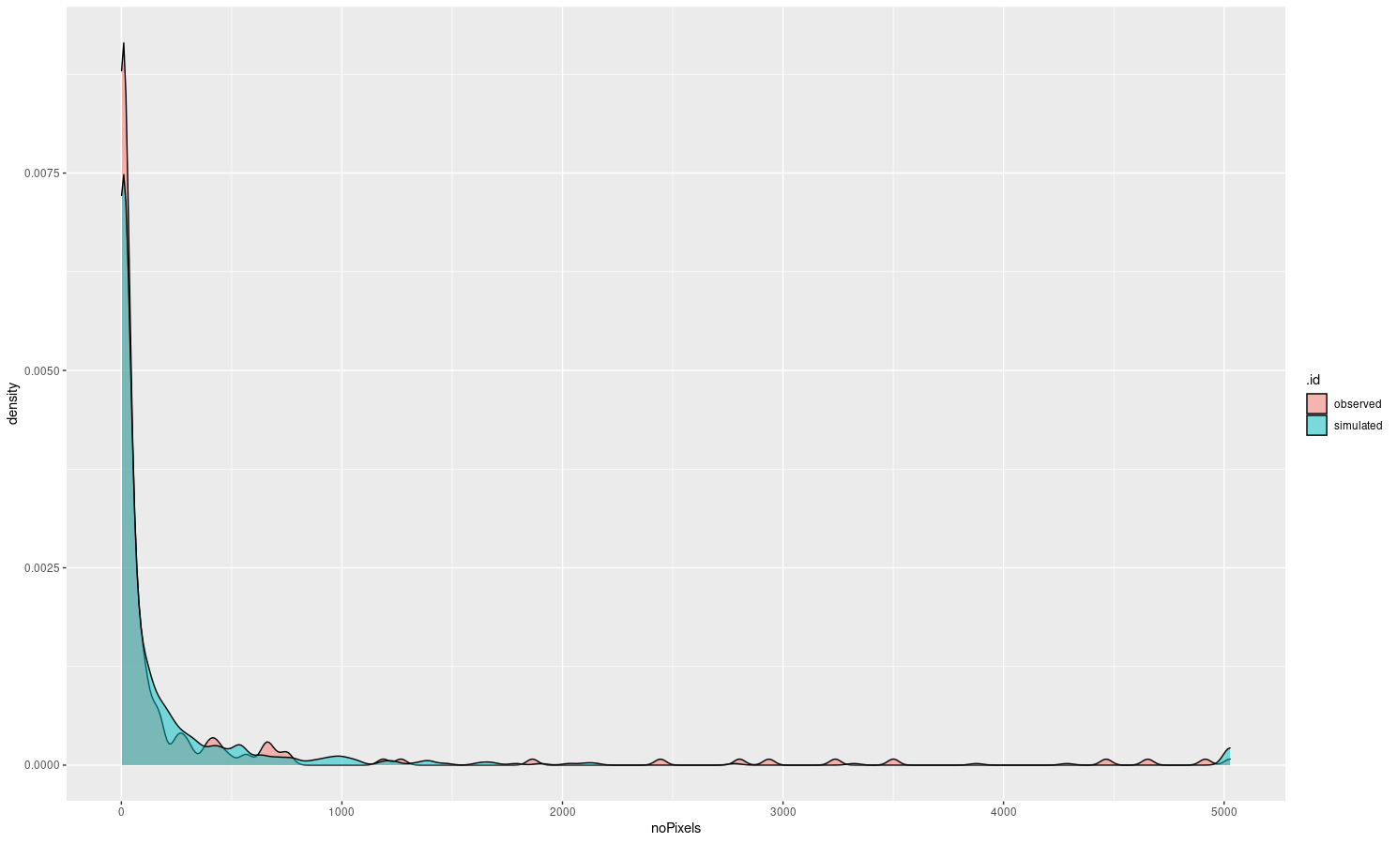
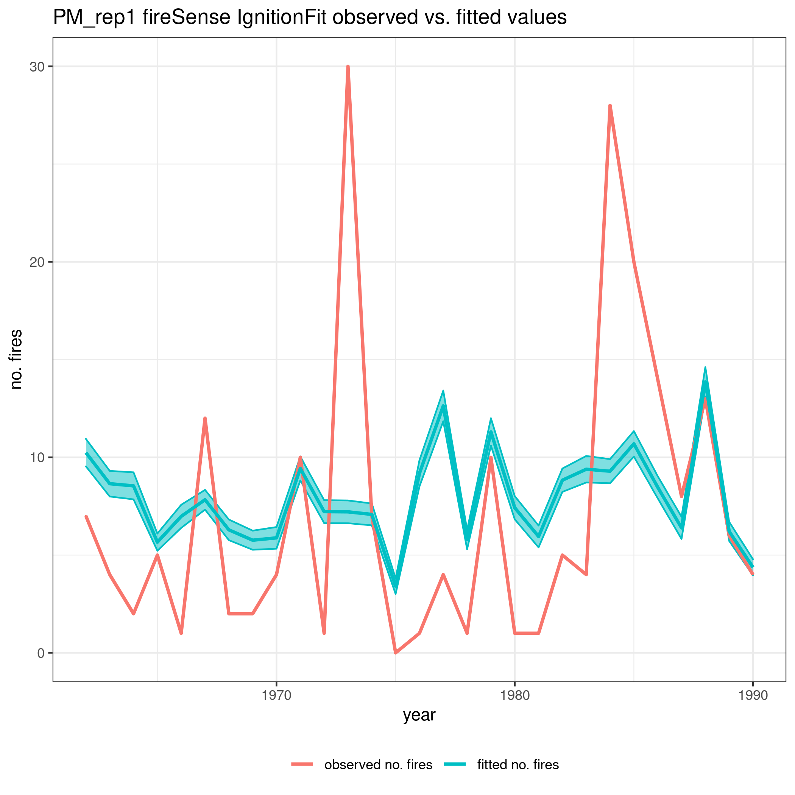
After passing .seed to FSIgnitionFit and ensuring the same fitted model
Spread probabilities rescaled to 0.23 – 0.25

Slide 12
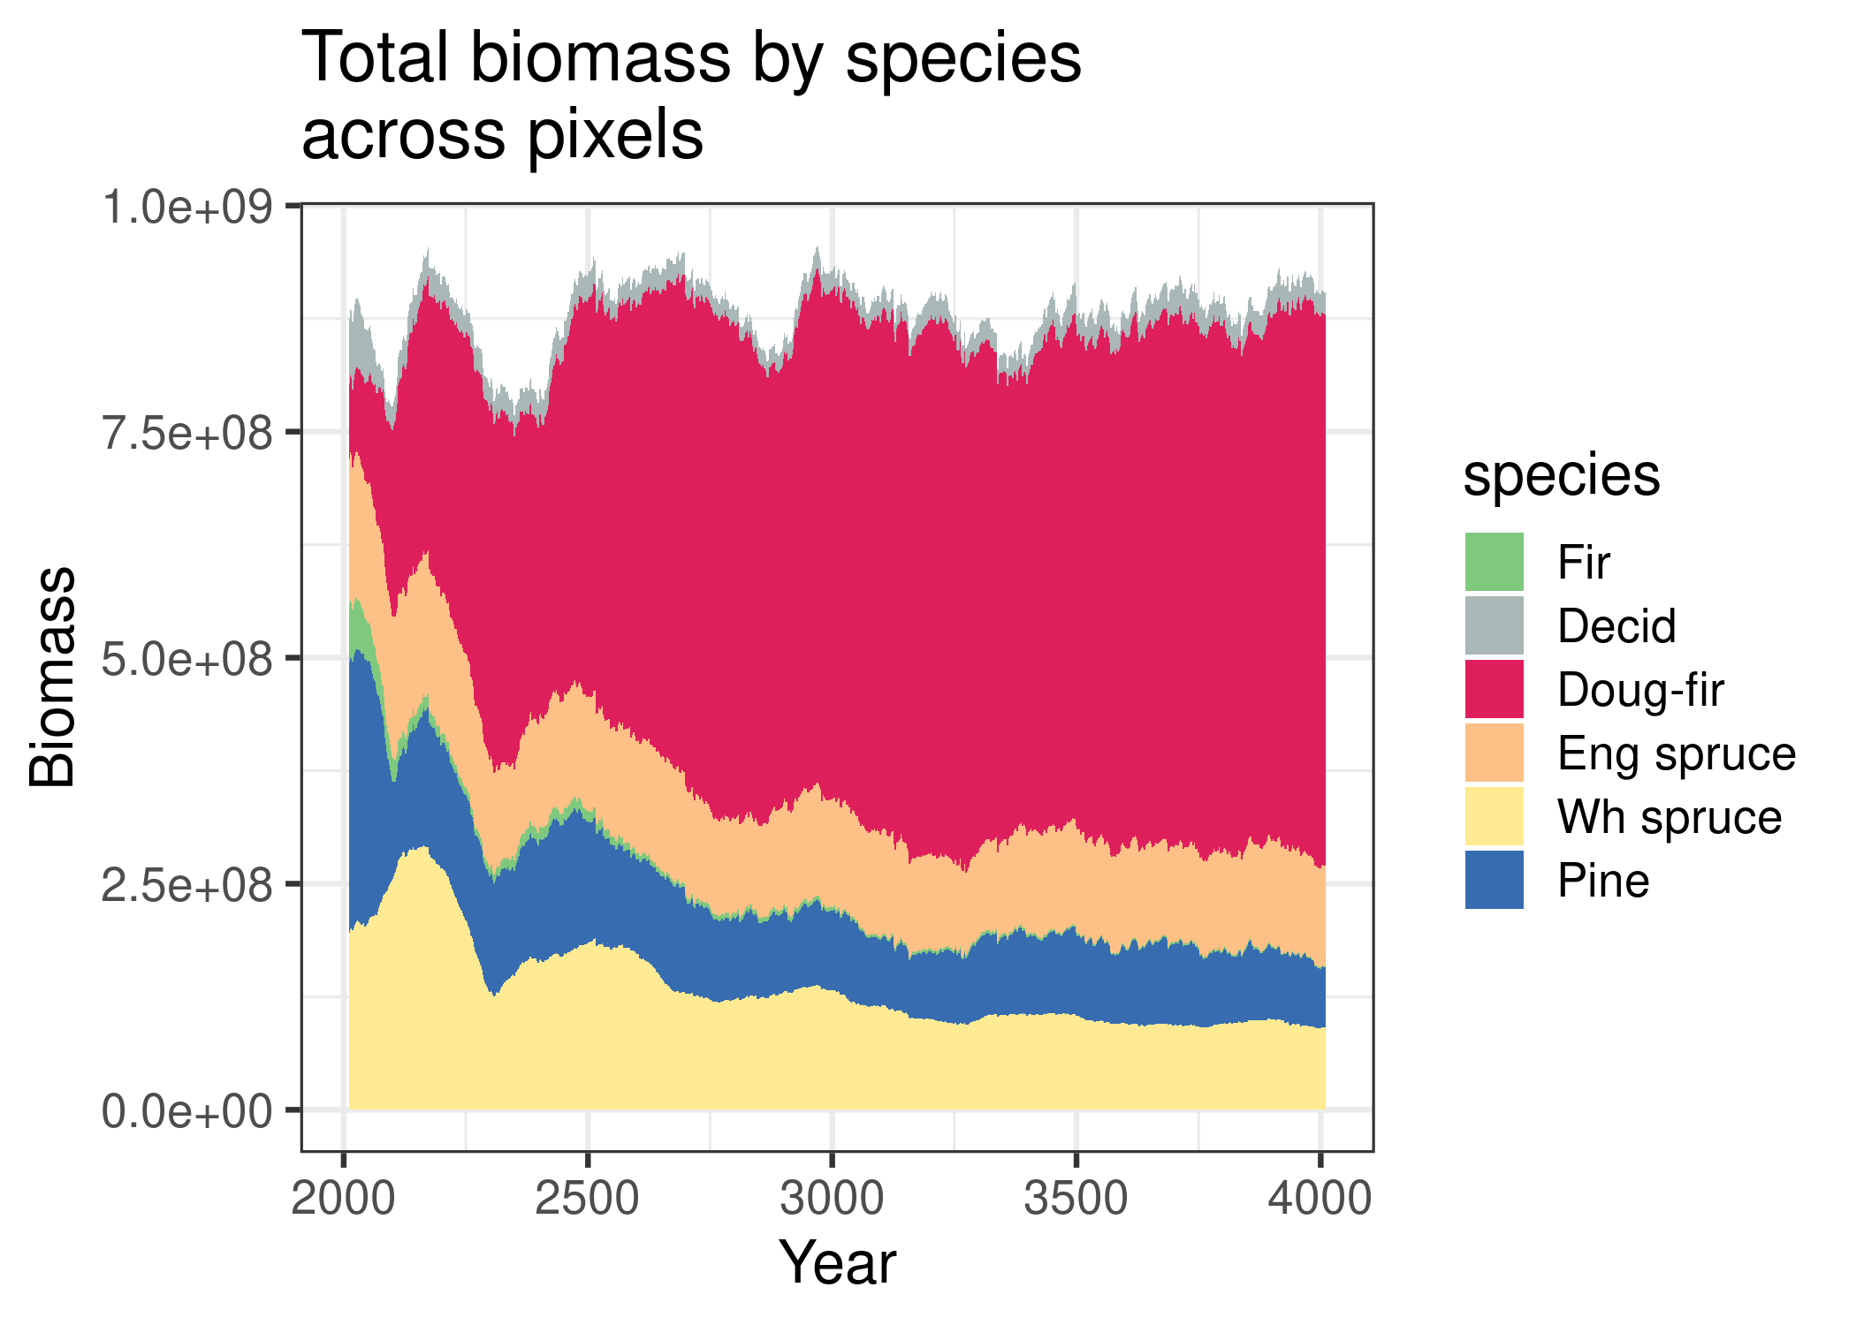
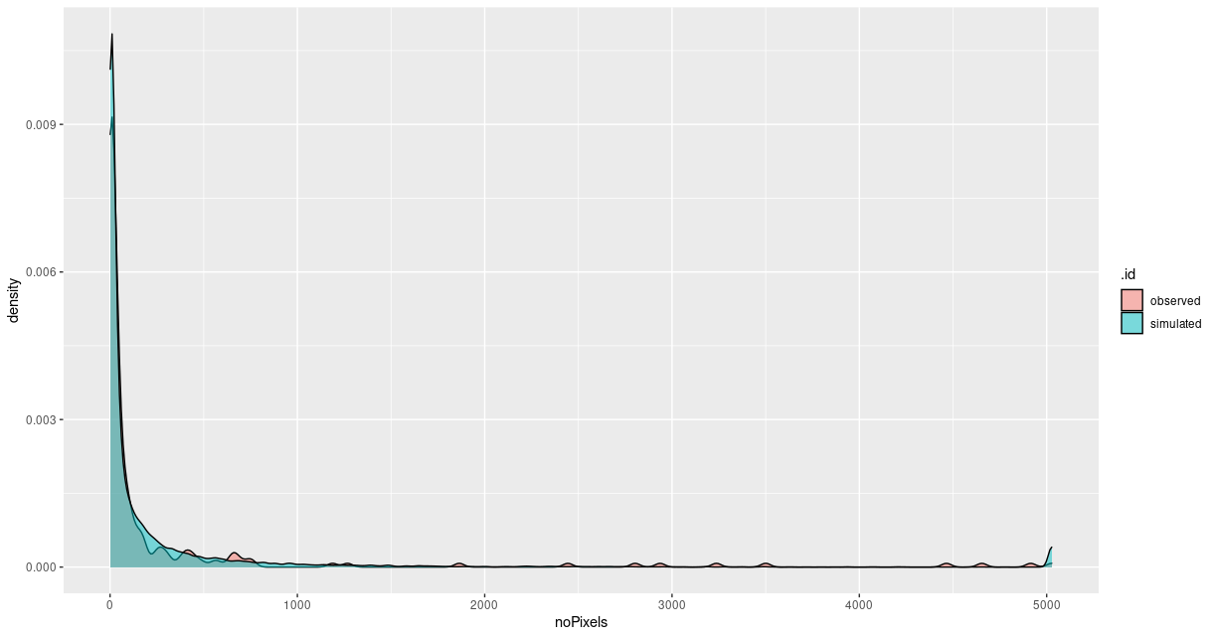
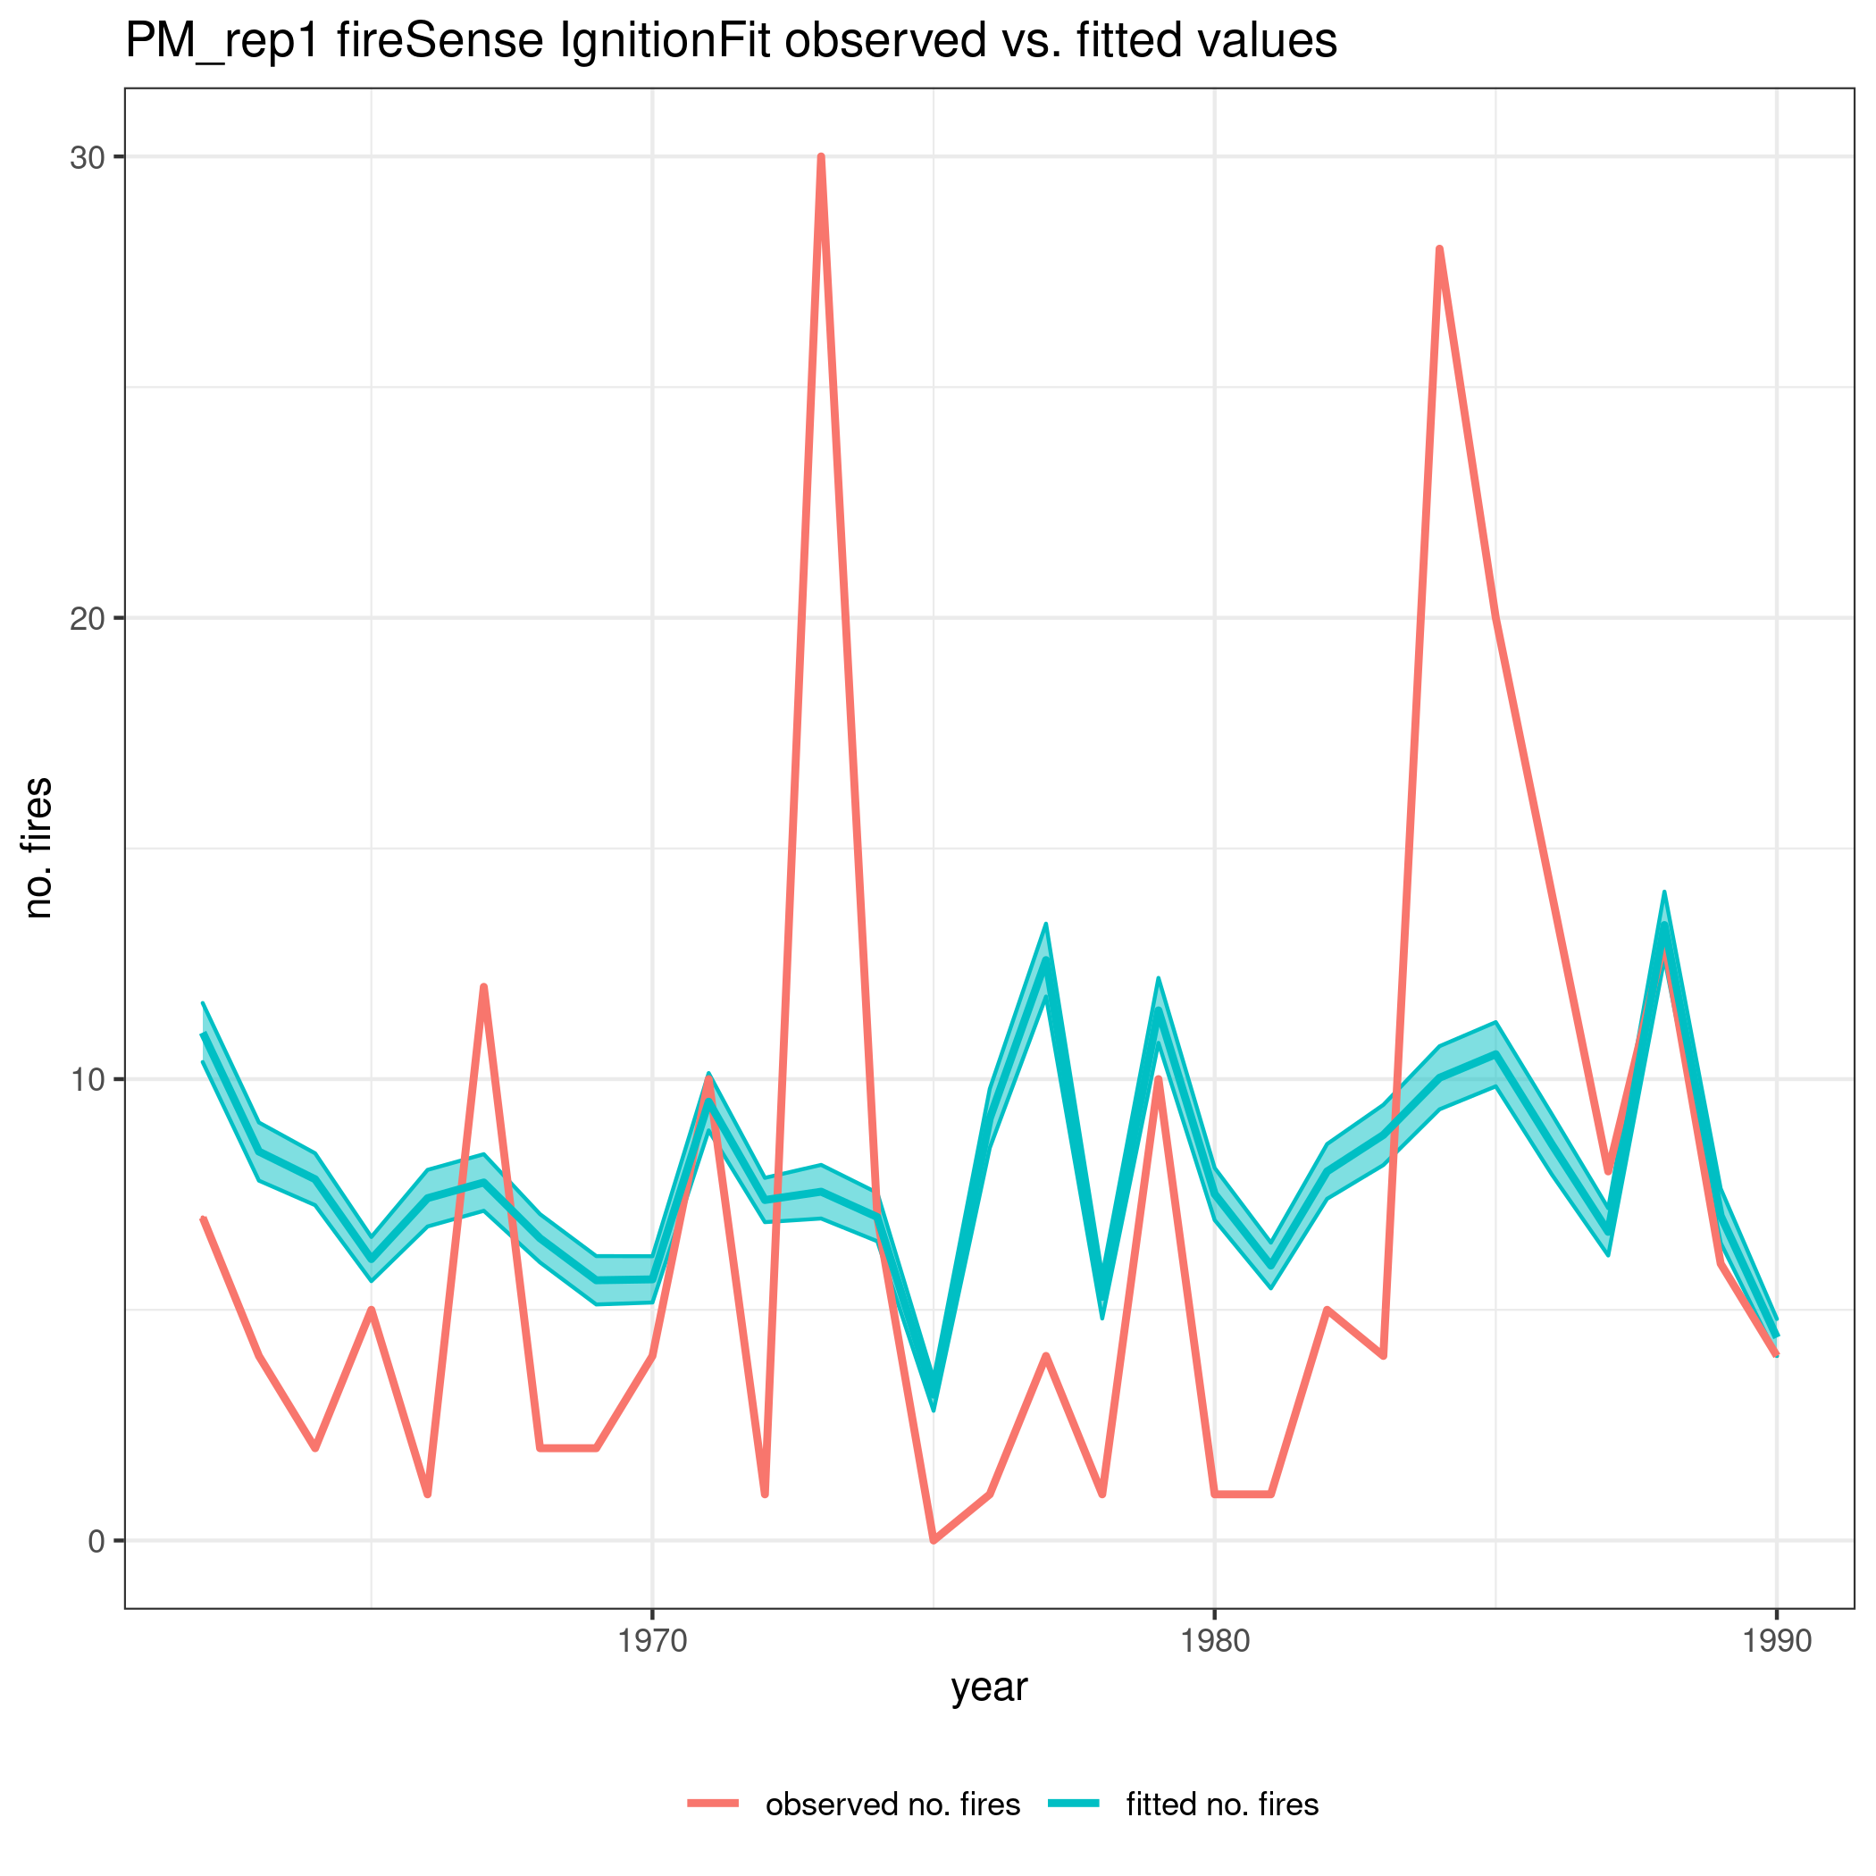
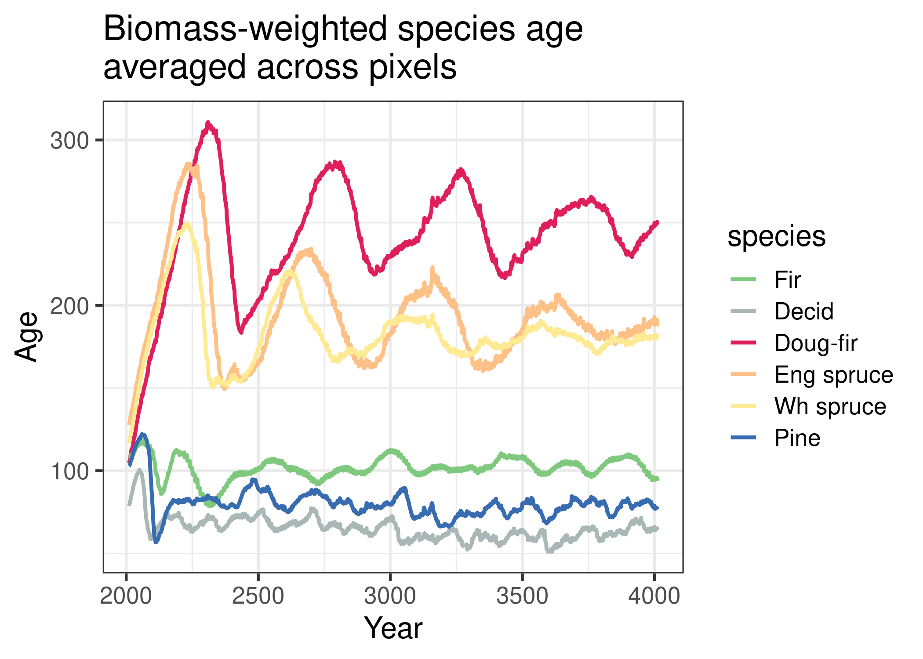
After passing .seed to FSIgnitionFit and ensuring the same fitted model
Spread probabilities rescaled to 0.23 – 0.25
2000yrs of sim

Slide 13
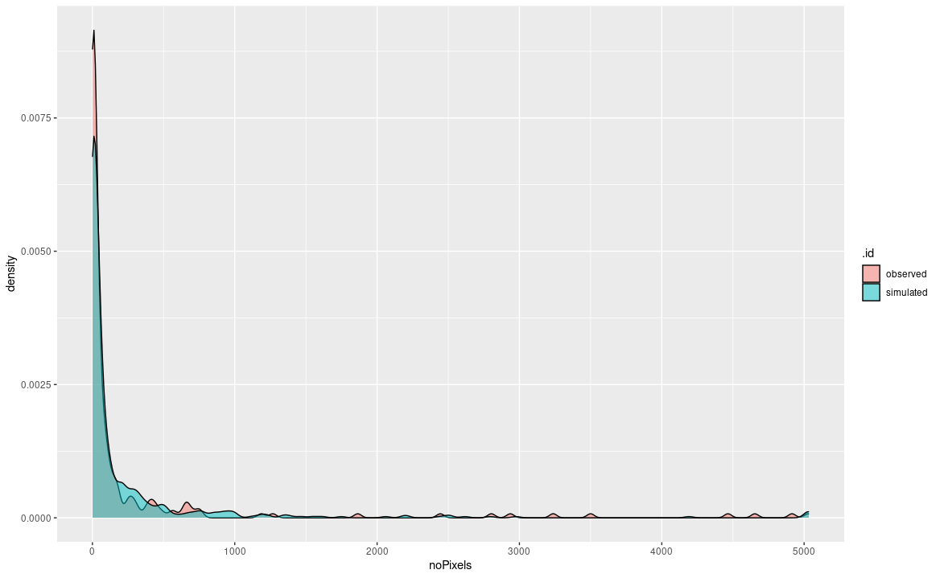
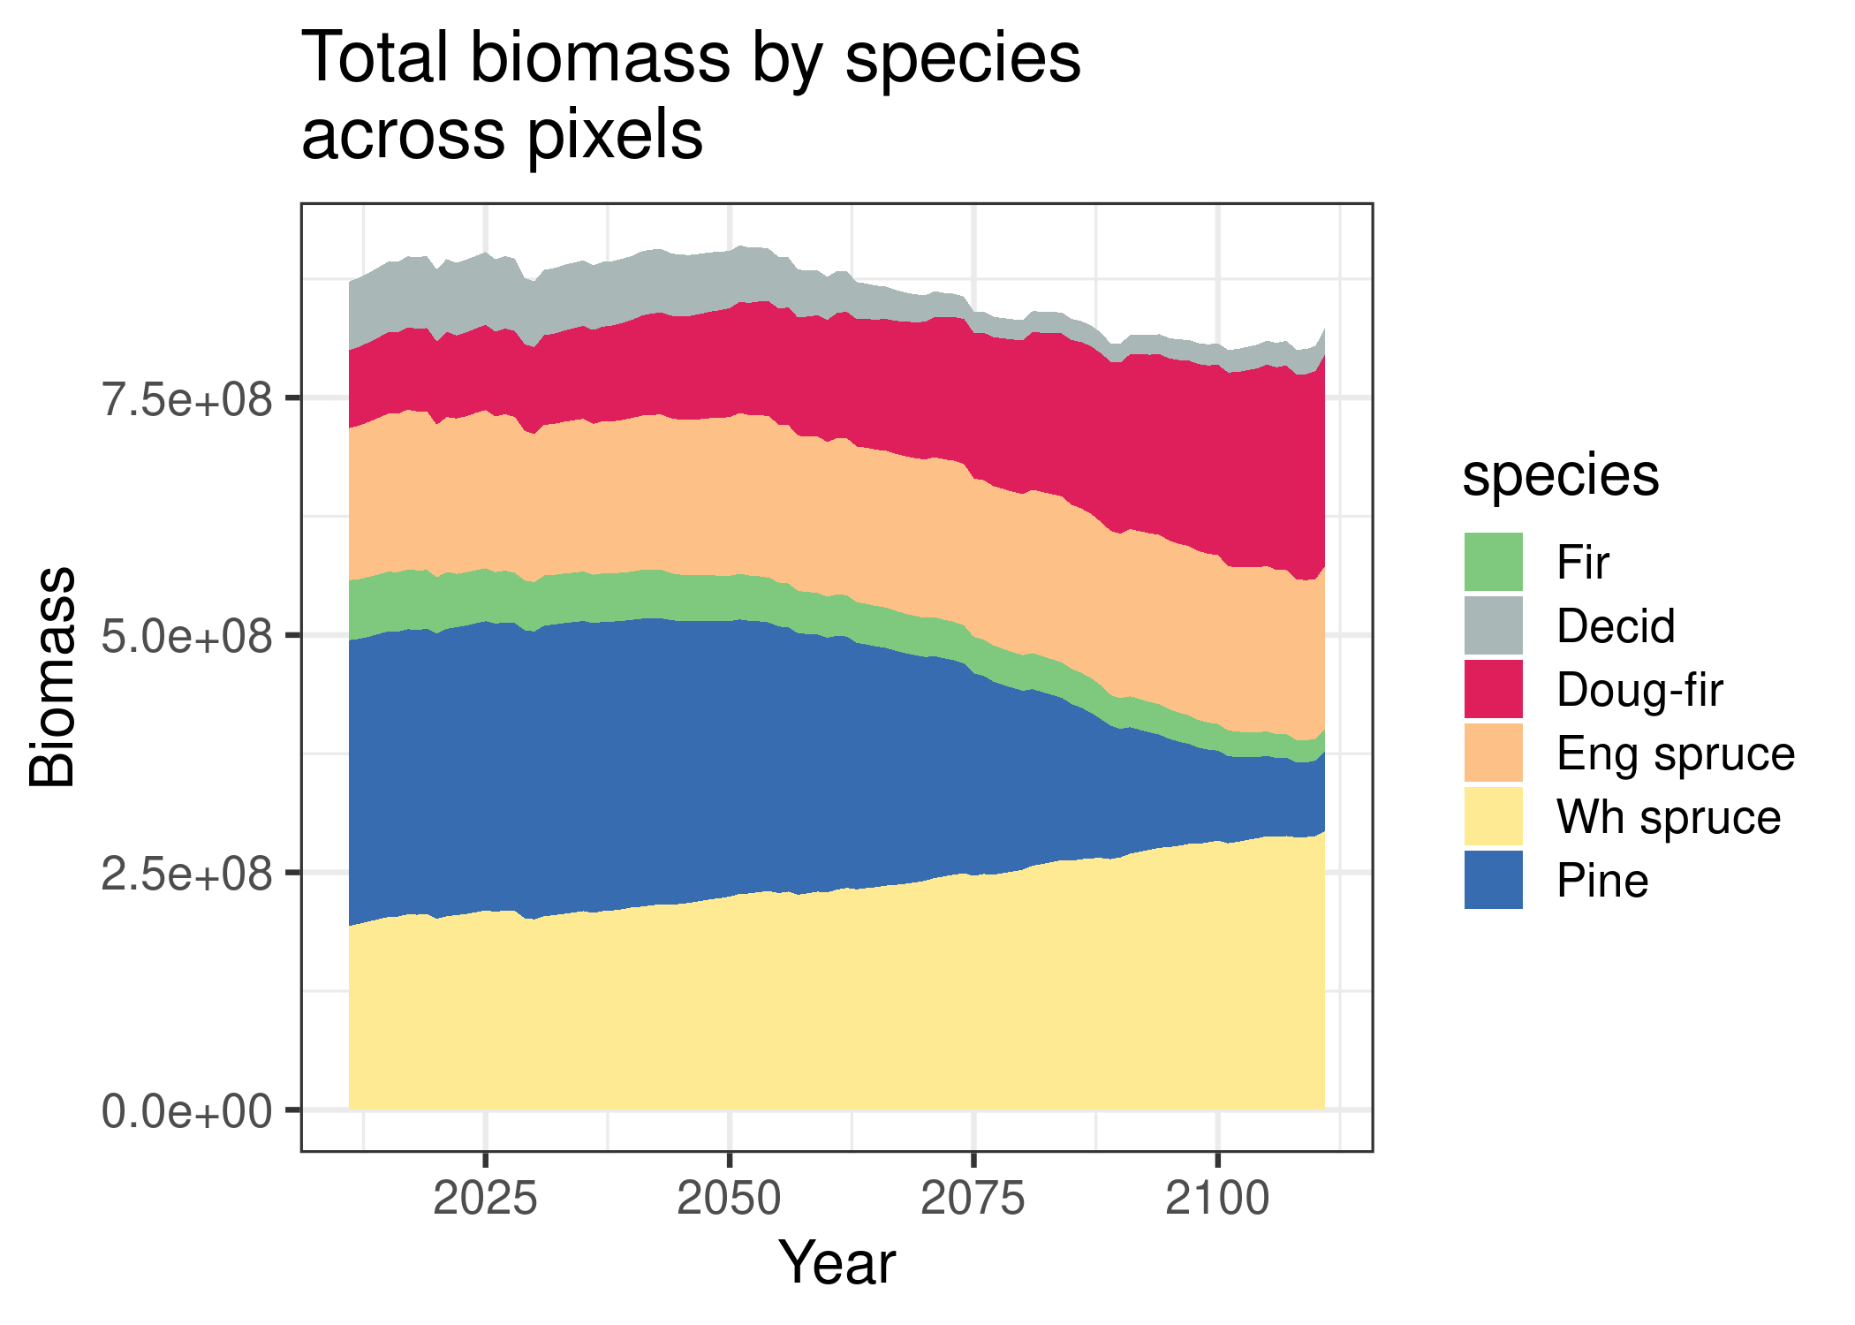
Spread probabilities rescaled to 0.23 – 0.26

